Slide 1
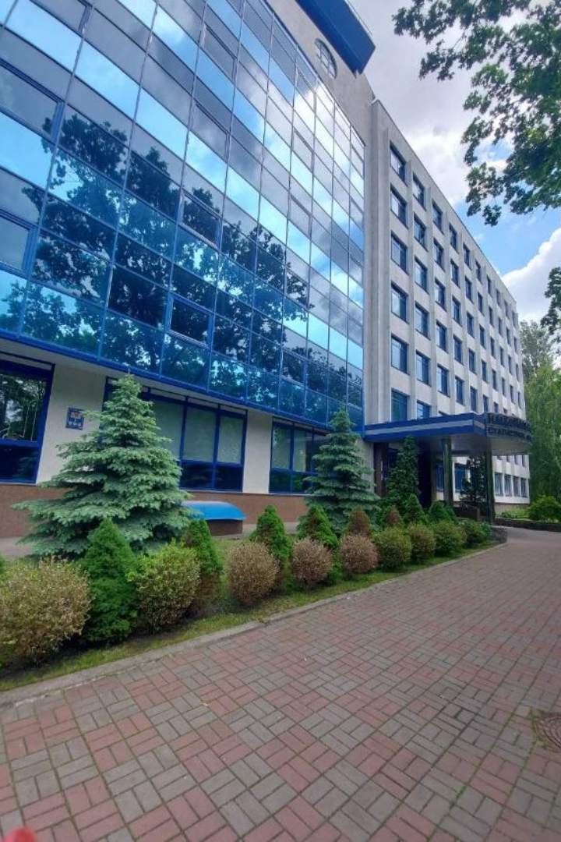

Admission to the National Academy of Statistics, Accounting and Audit for Foreigners and Non-Residents
Learn about admission, educational programs and peculiarities of studying at the Academy

Slide 2
List of State approved specialties (educational programs)
for foreigners and non-residents
List of specialties, educational programs, competitive disciplines for admission to study for Bachelor’s degree for foreigners and non-residents:
Field of Knowledge: D Business, Administration and Law
Field of Knowledge: 07 Management and Administration
Specialty: D3 Management
Specialty: 075 Marketing
Education and Professional Program: «Management of Foreign Economic Activity»
Education and Professional Program:
«Marketing and Advertising»
Field of Knowledge: D Business, Administration and Law
Field of Knowledge:D Business,Administration and Law
Specialty: D4 Public Management
and Administration
Specialty: D2 Finance, Banking, Insurance and
Stock Market
Education and Professional Program: "Public Management and Administration»
Educational Program: » Finance, Banking
and Insurance
List of Entrance Examination:
The Ukrainian Language
Mathematics

Slide 3
List of the specialties, educational programs, competitive disciplines for admission to study for Master’s degree for foreigners and non-residents
Field of Knowledge: D Business, Administration and Law
Specialty: D2 Finance, Banking, Insurance and Stock Market
Educational Program: Finance, Banking and Insurance
List of Entrance Examination:
      Foreign Language Exam
Professional Entrance Examination in the Field of Study

Slide 4
Stages of the admission campaign for foreign students at NASAA
Start of application period - 01 July 2026
The deadline for submitting applications and documents is not later than 23 October 2026
Timeline for entrance examinations for international students in specific subjects and languages of instruction, according to the Admissions Committee schedule of NASAA
Enrollment Period – not later than 01 November 2026

Slide 5




Tuition Fees & Accommodation Costs for the period of 2026/2027
Preparatory Department
Bachelor
$1000/year
$1,500/year
1
2
Start of Studies - 01.10.2026
Language of Instruction: Ukrainian
Language of Instruction: Ukrainian
Master
4
3
University Housing
$1800 /year
Dormitory fees from
1,500 UAH / month
Language of Instruction: Ukrainian

Slide 6







Language training for foreigners and n0n-residents is:
Intensive courses of the Ukrainian language from level А1 to level В1 during one educational year.
Immersion in the language environment. Live communication as a language learning method. Practice with native speakers and cultural exchange.
Mastering terminology. Individual classes and consultations.
Familiarization with the culture of Ukraine, understanding of habits, traditions, behavioral patterns, and communication styles.
Smooth integration into the cultural and educational environment.
Rapid and high-quality integration into the student community and daily life.

Slide 7

Life of a foreign student in Ukraine

Slide 8


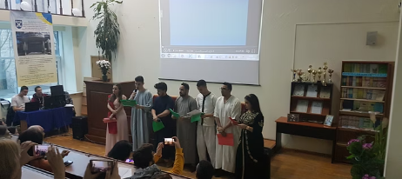
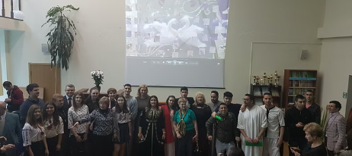
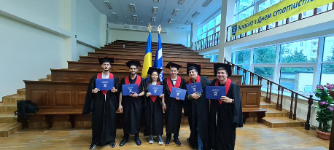
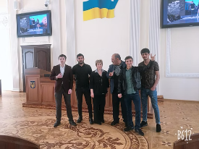

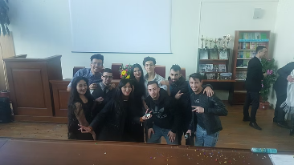
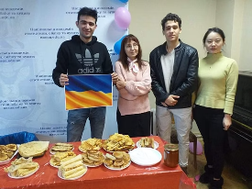




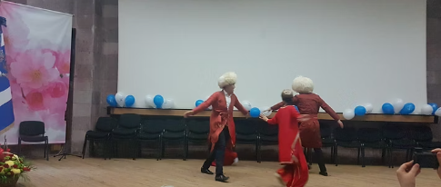

Being an international student at the Academy is about more than just studying — it's about living to the full. Every day is a new experience filled with interesting people, events, challenges, and the joy of discovery. Together, we build our student life — active, vibrant, and unforgettable.

Slide 9





Key Steps and Application Advice
Thoroughly review the admission regulations
Prepare the documents required for an official invitation to study
Select a major, mode of study, and entrance examination format
Contact the International Student Office for guidance and support
to international students of NASAA
https://apply.studyinukraine.gov.ua/home
International Student Office
Our guidance will help you successfully begin your studies in Ukraine.
For more detailed information, please visit the Academy's website.
Home

